Slide 1




SMART INDIA HACKATHON 2026
TITLE PAGE
  Problem Statement ID - 26136
  Problem Statement Title - Startup friendly public procurement mechanism that enables government departments to identify,pilot, procure, and scale innovative solutions from eligible startups
  Theme - Miscellaneous
  PS Category- Software
  Team ID-
  Team Name - LazyCoder’s 2.0

Slide 2

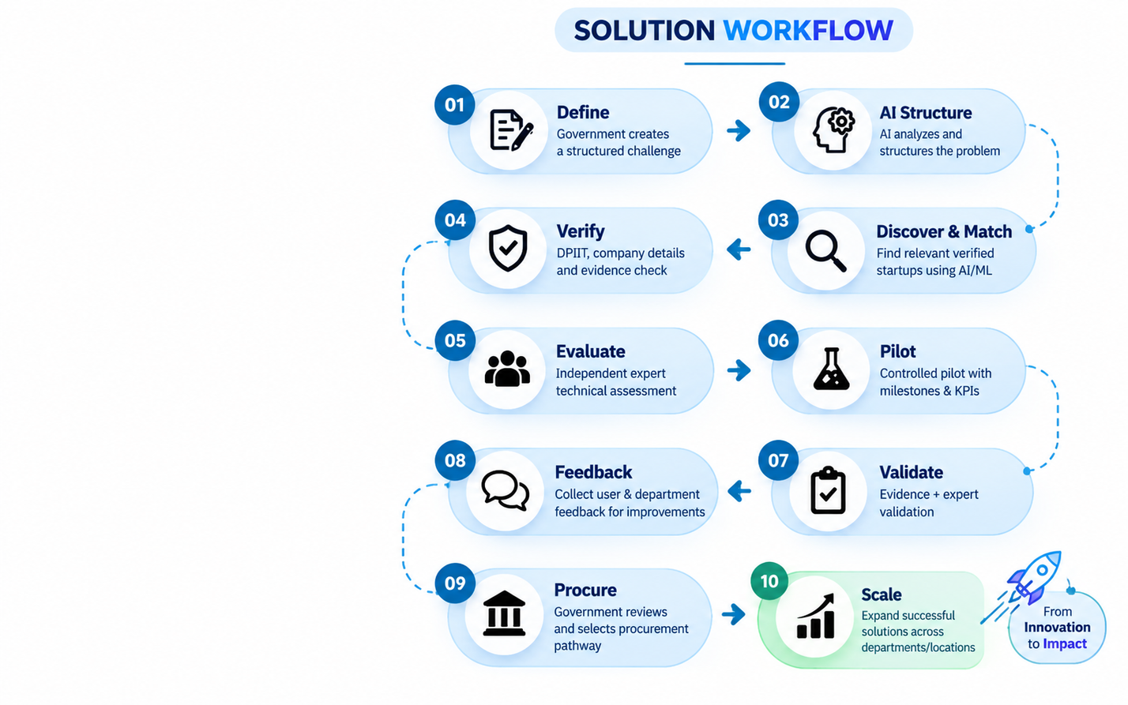
IDEA TITLE
PROPOSED SOLUTION
An AI-assisted Innovation-to-Procurement Platform that connects government departments with verified startups and takes successful innovations from problem identification to pilot, procurement and scale.
OUR SOLUTION — GOVINNOVATE
SOLUTION WORKFLOW
  Define: Government creates a structured challenge
  Discover and Match: AI/NLP finds relevant eligible startups
  Verify: DPIIT, company & evidence verification
  Evaluate: Independent expert technical assessment
  Pilot: Controlled pilot with milestones & KPIs
  Validate: Evidence + expert validation + user feedback
  Procure: Government reviews and selects applicable procurement pathway
  Scale: Successful solutions expand across departments/locations
  AI Problem-to-Startup Matching – Semantic matching based on problem, technology, sector and capability.
  Evidence-First Verification – Structured verification of startup credentials, claims and supporting evidence.
  Expert-in-the-Loop Evaluation – AI assists evaluation; domain experts validate technical evidence.
  Pilot-to-Procurement Bridge – Connects validated pilot outcomes with the appropriate procurement pathway.
  Milestone-Based Governance – Tracks KPIs, evidence, approvals and payment milestones throughout the pilot.
  RAG Policy Assistant – Provides policy/procurement guidance grounded in approved documents
KEY INNOVATIONS
@SIH Idea submission- Template
2

Slide 3





























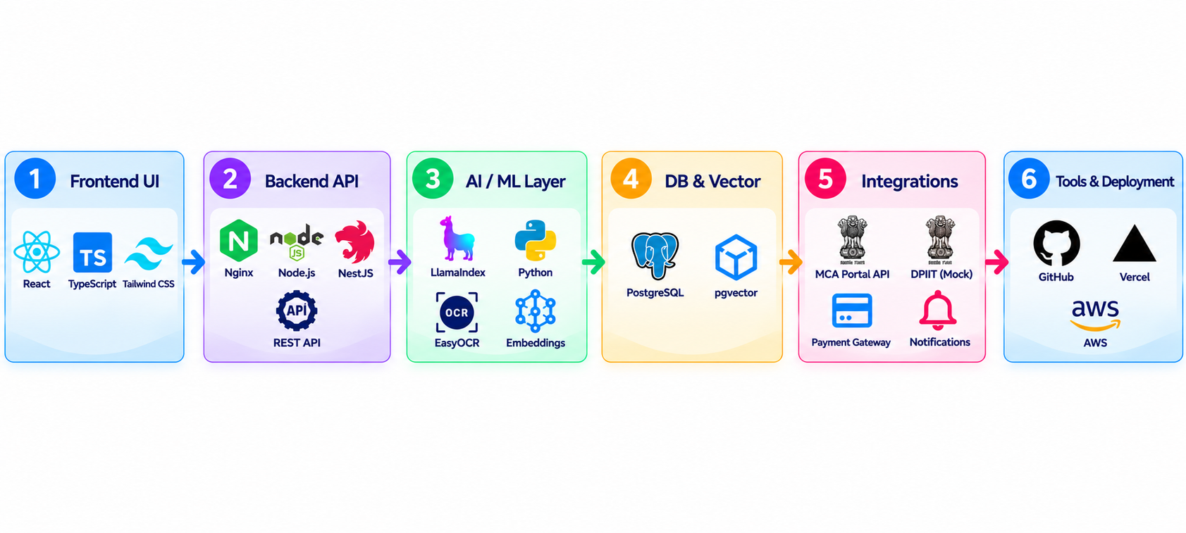

TECHNICAL APPROACH
StartUp
Registration
Document
Processing &
Verification
Government
Problem
StartUp
Submits Solution
Pilot
Monitoring
Rewards
Disbursement
AI/ML Model
Sorting
Verification Layer
StartUp01
KPI Evaluation
Store in Database
MileStones
DPIIT
Verificaton
CIN
Verification
PostgreSQL
+
pgVector
StartUp02
Expert Report
Mock Data
API
MCA
API
StartUp03
Scaling
Verified !
FeedBack
Technology Stack
@SIH Idea submission- Template
3

Slide 4


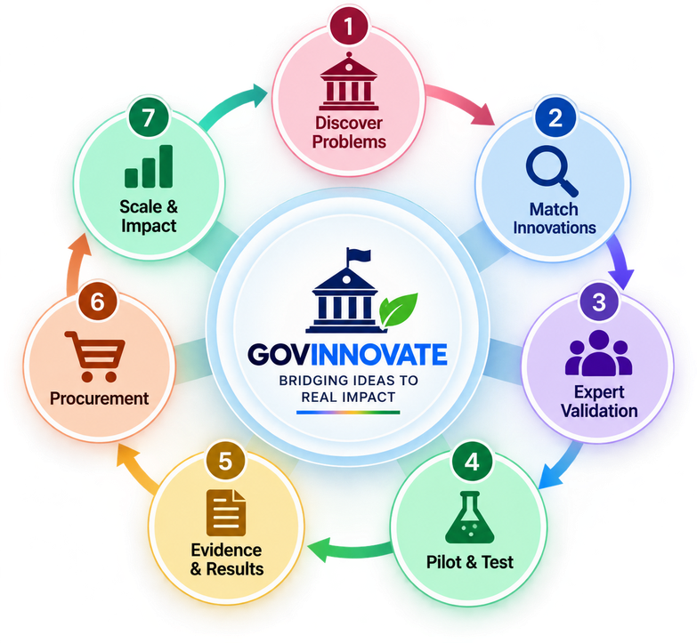









FEASIBILITY AND VIABILITY
FEASIBILITY
FEASIBILITY
VIABILITY
Can we build and implementn it
Can we build and implement it?
Can it be adopted, operated and scaled?
Technically Feasible
High Adoption Potential
Open-source and proven technologies: React/Typescript, Node.js, PostgreSQL + pgvector, LlamaIndex and Gemini APIs.
Solves real government problems and gives startups a clear path from pilot to procurement.
Operationally Feasible
Cost-Effective
Clear roles for Government, Startups, Experts, Admin and Citizens with defined workflows.
Uses existing infrastructure and open-source tools to reduce development and operational costs.
Data Feasible
Scalable Model
Public documents, government challenge data and startup submissions can be securely stored with audit logs.
Modular, cloud-ready and replicable across departments and states.
Implementation Feasible
Long-Term Value
Modular, API-first and prototype-ready design enables phased development.
Improves public service delivery and creates measurable social and economic impact.
We have what it takes.
The building blocks exist.
Not just possible.
Built for long-term impact
BUILD
PILOT
SCALE
IMPACT
PILOT
@SIH Idea submission- Template
4

Slide 5

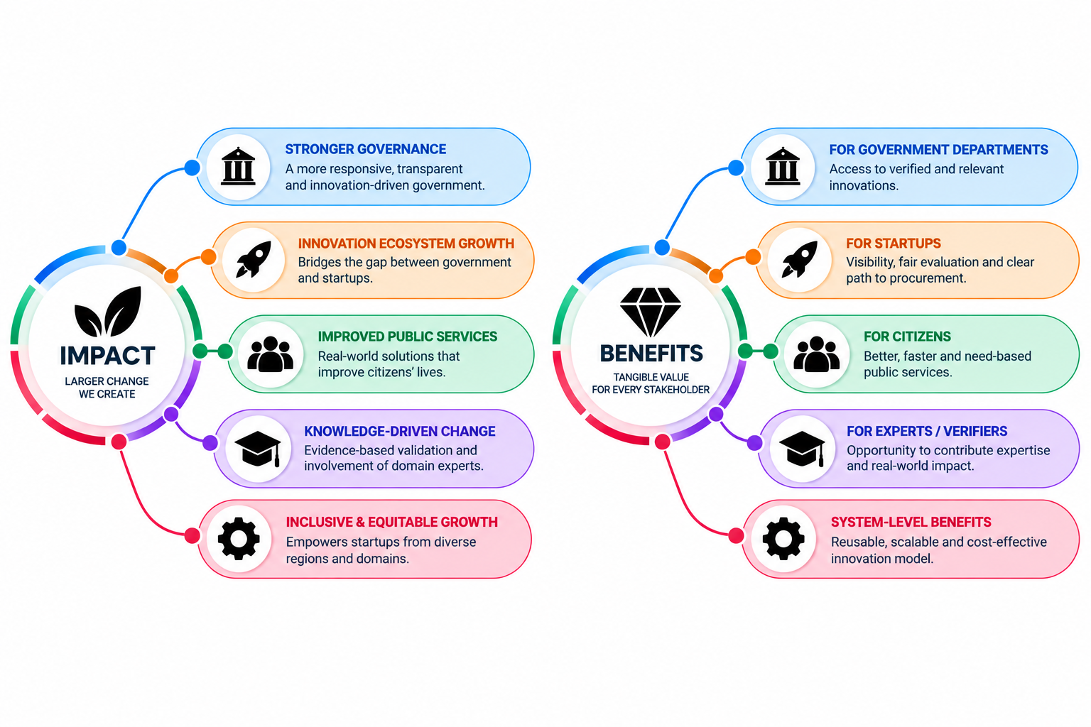
IMPACT AND BENEFITS
@SIH Idea submission- Template
5

Slide 6



RESEARCH AND REFERENCES
REFERENCES
  Maharashtra State Innovation Society (MSInS) —https://msins.in/
  Manual for Procurement of Goods – 2024 — https://doe.gov.in/manuals
  General Financial Rules (GFR), 2017 — https://doe.gov.in/bi-annual-compilationupdation-general-financial-rules-2017-upto-31012026general-financial-rules
  Startup India – Public Procurement — https://www.startupindia.gov.in/content/sih/en/public_procurement.html
  GeM— https://gem.gov.in/
RESEARCH PAPER
  Strengthening Startup Engagement in Public Procurement: An Incubator-Led Approach to GeM Enablement in India- https://papers.ssrn.com/sol3/papers.cfm?abstract_id=6530078
  On Recent Advances in Public Procurement: An Exploration of the Government e-Marketplace in India--https://onlinelibrary.wiley.com/doi/abs/10.1002/pad.2113
GitHub Repo
Report
Prototype
@SIH Idea submission- Template
6

